Slide 1
scRNA-seq Analysis
CDS-SR scRNA-seq Workshop 2022
(Section 1)
Supplemental Slides
Slide 1

Slide 2
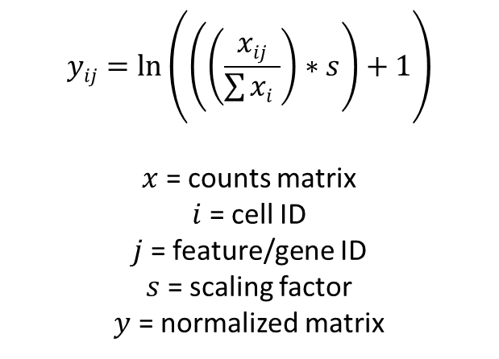
Supplemental: Normalization
LogNormalize Algorithm
Steps:
Divide Count value for a feature in a cell by total count for a cell
Multiply by scaling factor (ie. 10000)
Add 1
Take natural log
$$yij=\ln\left(\left(\left(\frac{xij}{\sum{xi }}\right)∗s\right)+1\right)$$
$x$ = counts matrix
$i$ = cell ID
$j$ = feature/gene ID
$s$ = scaling factor
$y$ = normalized matrix
Slide 2

Slide 3
Supplemental: Finding Variable Features
vst Algorithm
Steps
Fit a line to relationship of ln(var) and ln(mean) using local polynomial regression (loess)
Standardize feature value using observed mean and expected variance (from fitted line)
Calculate feature variation on standardize values after clipping to max
Slide 3

Slide 4
Supplemental: Clustering
Finding neighbors
K-nearest neighbor (KNN) graph Algorithm
Draws edges between cells with similar expression patterns
Partitions graph into highly interconnected “communities”
Based on Euclidean distance in PCA space
Refine edge weights between any 2 cells based on shared overlap in their local neighborhoods (Jaccard)
Uses PCs from PCA
Slide 4

Slide 5
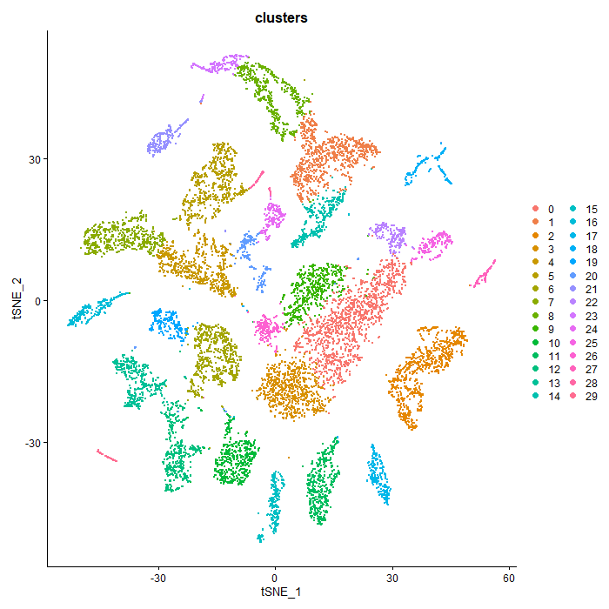
Supplemental: Non-Linear Reduction
t-Stochastic Neighborhood Embedding (tSNE)
Steps:
Uses a Gaussian probability function to calculate how likely a cell will pick another cell as a neighbor for every cell
Rearranges cells based on these distances to low-dim space
Slide 5
Notes:
Read all bullet points
Explain plot
clusters are mostly evenly spaced from each other

Slide 6
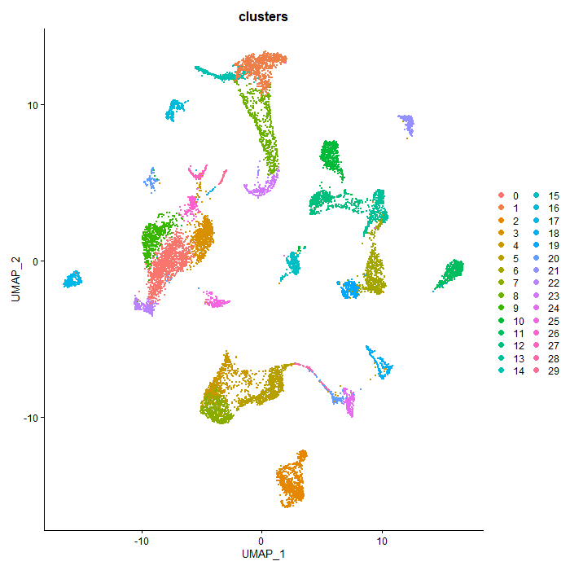
Supplemental: Non-Linear Reduction
Uniform-Manifold Approximation and Projection (UMAP)
Steps:
Creates a fuzzy graph that reflect topology/shape of the high-dimensional graph
Calculates weight for edges in graph
Build low-dimensional graph mimicking fuzzy graph
Slide 6
Notes:
Read all bullet points
Explain plot
distance vary among clusters and more compact

Slide 7
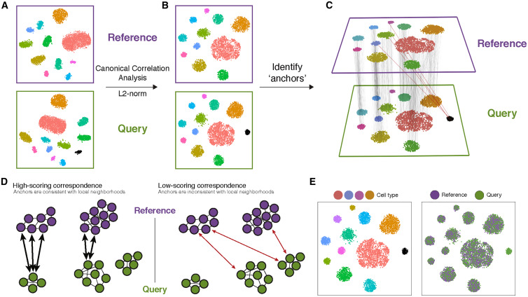
Supplemental: Batch Correction/Integration
Seurat Integration
“Align” shared cell populations across datasets
Steps:
Identify anchors
Pairwise combinations of reference and query datasets to find anchors
Use anchors to “correct” values for each cell and integrate datasets
Can use either CCA or RPCA algorithms
https://www.cell.com/cell/fulltext/S0092-8674(19)30559-8
Slide 7

Slide 8
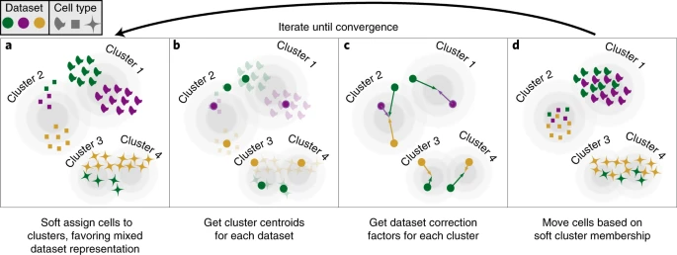
Supplemental: Batch Correction/Integration
Harmony
Steps:
Low-dimensional embedded (ex: PCA) cells are soft assigned to clusters
Calculate cluster centroids for each dataset
Calculate correction factors for each cluster
Move cells based on soft cluster membership
https://www.nature.com/articles/s41592-019-0619-0
Slide 8

Slide 9
Supplemental: Pathway Analysis
Functional class scoring (FCS)
Gene Set Enrichment Analysis (GSEA)
Steps:
Calculation of enrichment score (ES)
Walk down list and calculate running-sum statistic
Increase when encounter gene in gene set of path
Decrease when encounter gene not in gene set of path
Magnitude on increment depends on correlation of gene with phenotype
ES is max deviation from 0
Estimation of significance level of ES
p-value is calculated by empirical phenotype-based
Adjustment for multiple hypothesis testing
Normalize ES to account for size of gene set
Make normalized ES (NES)
Calculate FDR or other multiple testing correction values
Slide 9

Slide 10
Supplemental: Gene Regulatory Networks (GRN)
Algorithms
Boolean models
Activated/repressed
Ordinary differential equation (ODE) models
Change in expression over continuous time is characterized by function that takes inhibitory/activating influence of other genes as variables
Regression models
Random Forest
Correlation and other association models
Mutual information (MI) models
Filtration of reference gene networks
Data is used to fine-tune known reference network (ex: pathway)
Slide 10

